Slide 1

4: Web Mining
152.152.98.11 - - [16/Nov/2005:16:32:50 -0500] "GET /jobs/ HTTP/1.1" 200 15140 "http://www.google.com/search?q=salary+for+data+mining&hl=en&lr=&start=10&sa=N" "Mozilla/4.0 (compatible; MSIE 6.0; Windows NT 5.1; SV1; .NET CLR 1.1.4322)“
252.113.176.247 - - [16/Feb/2006:00:06:00 -0500] "GET / HTTP/1.1" 200 12453 "http://www.yisou.com/search?p=data+mining&source=toolbar_yassist_button&pid=400740_1006" "Mozilla/4.0 (compatible; MSIE 6.0; Windows NT 5.1; SV1; MyIE2)"
252.113.176.247 - - [16/Feb/2006:00:06:00 -0500] "GET /kdr.css HTTP/1.1" 200 145 "http://www.kdnuggets.com/" "Mozilla/4.0 (compatible; MSIE 6.0; Windows NT 5.1; SV1; MyIE2)"
252.113.176.247 - - [16/Feb/2006:00:06:00 -0500] "GET /images/KDnuggets_logo.gif HTTP/1.1" 200 784 "http://www.kdnuggets.com/" "Mozilla/4.0 (compatible; MSIE 6.0; Windows NT 5.1; SV1; MyIE2)"
Visit Analysis
152.152.98.11 - - [16/Nov/2005:16:32:50 -0500] "GET /jobs/ HTTP/1.1" 200 15140 "http://www.google.com/search?q=salary+for+data+mining&hl=en&lr=&start=10&sa=N" "Mozilla/4.0 (compatible; MSIE 6.0; Windows NT 5.1; SV1; .NET CLR 1.1.4322)“
252.113.176.247 - - [16/Feb/2006:00:06:00 -0500] "GET / HTTP/1.1" 200 12453 "http://www.yisou.com/search?p=data+mining&source=toolbar_yassist_button&pid=400740_1006" "Mozilla/4.0 (compatible; MSIE 6.0; Windows NT 5.1; SV1; MyIE2)"
252.113.176.247 - - [16/Feb/2006:00:06:00 -0500] "GET /kdr.css HTTP/1.1" 200 145 "http://www.kdnuggets.com/" "Mozilla/4.0 (compatible; MSIE 6.0; Windows NT 5.1; SV1; MyIE2)"
252.113.176.247 - - [16/Feb/2006:00:06:00 -0500] "GET /images/KDnuggets_logo.gif HTTP/1.1" 200 784 "http://www.kdnuggets.com/" "Mozilla/4.0 (compatible; MSIE 6.0; Windows NT 5.1; SV1; MyIE2)"

Slide 2
Web Usage Mining – Visit Analysis
For improving conversion on
  Shopping cart, ad clicks, music downloads, …
Hit-level analysis is insufficient
Related requests (hits) should be combined into a visit

Slide 3
What is a Visit?
Related requests from a (more-or-less) contiguous visit to the website
We focus on human* visits
Focus on primary files
  * visits from Googlebot and other search engine bots can be important for SEO (search engine optimization)

Slide 4
Web site visit – simple definition
Requests from the same IP address*
Interval between consecutive requests < MAX_INTERVAL (e.g. 30min)*
Same user agent*
Human visits have additional
structure which can be detected
*there may be some exceptions, which we ignore for now

Slide 5
Human Web Site Visit
A human visit consists of
  Primary files - requested directly by a human visitor (e.g. via a click)
    Usually HTML pages, but not always
  Component files - requested automatically by a browser as part of primary files (e.g. javascript, jpg or gif images)
  (possibly) Special files - requested automatically by some browsers (e.g. favicon.ico), but not part of primary files

Slide 6
Primary files – HTML pages
Static: file name ends in *.html, *.htm, or / (directory)
  Exceptions are possible: Some HTML pages can be generated dynamically and are non-primary. E.g. /aps/*.re.html pages in KDnuggets log are generated by Javascript and are not primary
Dynamic: generated by PHP, Perl or other script;
  file name is the name of the script, after removing the ? … parameters
  common extensions are: .shtml, .php, .pl, .cgi , .jhtml
  specific for each site (KDnuggets has .pl and .php pages)

Slide 7
Primary files – non HTML
Non-HTML files requested directly by a human via a browser
Common file types:
  Documents: .pdf, .ppt, .doc, .xls, .txt, .zip
  Media files: .avi, .mov, .mp3, …
  …
A typical web site has a limited number of different file types
KDnuggets Nov 16, 2005 log has < 20 types.

Slide 8
Component files
Requested automatically as part of primary HTML pages (usually).
  Image files: .jpg, .gif, .png, .bmp
  Cascading Style Sheets: .css
  Javascript: .js
    Javascript can also generate component files with .html, .gif, or other extensions
  …

Slide 9
Special files
Requested automatically by bots or browsers without a direct human request
robots.txt – requested by "good" bots
  indicates a bot visit
favicon.ico – requested by MS Internet Explorer
  can be treated as a component – indicates a human visit
_vti_/* files – requested by some MS Office extension – usually not found

Slide 10
File parsing complications
Some file requests have additional structure AFTER the file name, which should be removed to get the file type
Parameters, e.g
  /swh.gif?width=1024&height=768
Name anchors, e.g.
  /news/96/#item9

Slide 11
Request optional parameters: ?
Optional parameters complicate processing
Example:
"GET /swh.gif?width=1024&height=768 HTTP/1.0"
Here the optional parameter: ?width=1024&height=768
should be removed to get the file name swh.gif
Convention: anything in a request file name following ? is a parameter

Slide 12
Name anchors
Example request
  "GET /news/96/#item5 HTTP/1.0"
Remove anything following # from the file name

Slide 13
File parsing – bad requests
Note: bad requests (404 status code) can have any garbage in the file name
Analyze file names for requests with status
  200 – OK
  304 – not modified
  206 – partial request
Count bad requests (404) but do not parse their file names

Slide 14
Visit – Example 1
Time | GET | Referrer
09:17:09 | /courses/webcasts.html | http://www.google.com/search?hl=en&q=SAS+webinars&btnG=Google+Search
09:17:09 | /kdr.css | /courses/webcasts.html
09:17:09 | /aps/aw2.js | /courses/webcasts.html
09:17:10 | /aps/t-mega-pa.c13.gif | /courses/webcasts.html
09:17:10 | /images/newy.gif | /courses/webcasts.html
09:17:10 | /aps/rw2.js | /courses/webcasts.html
09:17:10 | /aps/x-ang-asa.c8.gif | /courses/webcasts.html
09:17:10 | /aps/r-sas-1019em.c6.gif | /courses/webcasts.html
Primary
component
component
component
component
component
component
component
(note: IP, day, GET, Status code, and user agent were the same and omitted here, as well as requests from other IP)
Observation: components are usually listed in the order they
appear in a page

Slide 15
Human Visits
For human visitors
> 1 Primary page requests
HTML Primary page requests should be followed by their component requests*
2nd and following primary page referrals should be from previous primary pages
Human click-thru speed
*Exceptions for browser cache, multiple windows/tabs, …

Slide 16
“Good” Bots visit robots.txt
A good bot is supposed to visit robots.txt file
Visits from IP address that visit robots.txt within some time interval (hour ? day?) can be assumed to be from bots

Slide 17
Example - Bad Bot?
IP | Time | GET | Referral
ip2 | 0:54:12 | / | -
ip2 | 0:54:17 | /software/ | -
ip2 | 0:56:16 | / | -
ip2 | 0:56:21 | /software/ | -
ip2 | 1:14:56 | / | -
ip2 | 1:15:01 | /software/ | -
ip2 | 1:52:41 | / | -
ip2 | 1:52:46 | /software/ | -
ip2 | 12:15:39 | / | -
ip2 | 12:15:45 | /software/ | -
ip2 | 21:09:20 | / | -
ip2 | 21:09:26 | /software/ | -
Bad bots
  Have human browser user agent
  Can be identified by behavior (e.g. no component requests)
  Actual visit example
  Is it a bot?
User Agent: "Mozilla/4.0 (compatible; MSIE 5.5; Windows XP)"

Slide 18
Human or Bot ?
Download agents
    E.g. Faster Fox extension to Firefox downloads all links on a page
    DA Downloadaccelerator download manager

Slide 19
Bot traps
One way to catch some bad bots is to use bot "traps"
Embed in your HTML page an invisible link to a 1x1 gif file a.gif
<a href=bt1.html><img border=0 src=a.gif></a>
Requests to bt1.html file would be from bots
  Note: without border=0 the link would be visible

Slide 20
Advanced Bot Trap
Put btrap1.html into a directory forbidden to good bots by robots.txt file
<a href=/bdir/bt1.html><img border=0 src=/bdir/a.gif></a>
In robots.txt specify
  User-agent: *
  Disallow: /bdir
Then all hits on /nbdir/bt1.html are from bad bots
Search engines will not index it

Slide 21
Visit Analysis
Collect visit information
Classify visits into Human/Bots

Slide 22
Summary
Primary, component, and special pages
Bot or Not

Slide 23
A Sample of
Interesting
Web Log Analysis
Reports

Slide 24
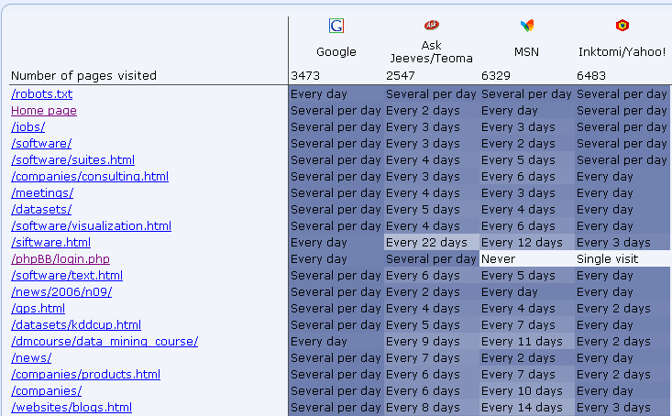
ClickTracks: Robot Report
Sample report for KDnuggets, one week in May 2006
Frequency of visits

Slide 25
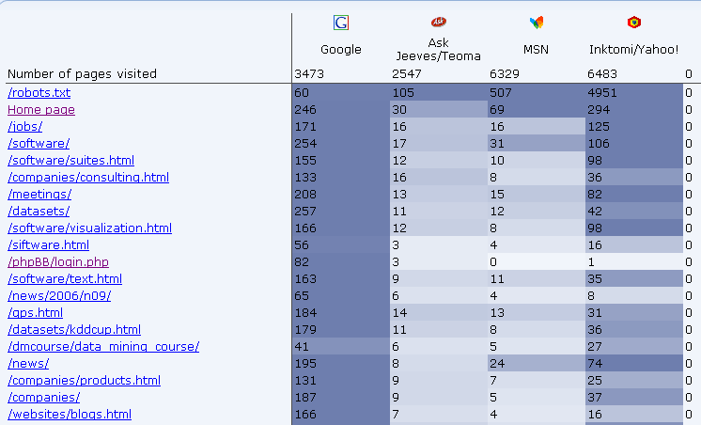
ClickTracks Robot Report
Number of visits

Slide 26
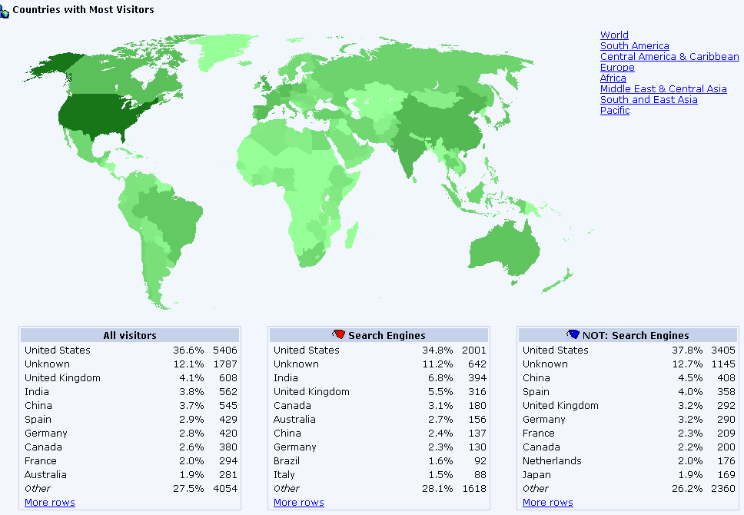
ClickTracks: Country Report
For KDnuggets, week of May 21-27, 2006 (partial data)

Slide 27
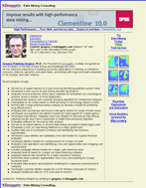
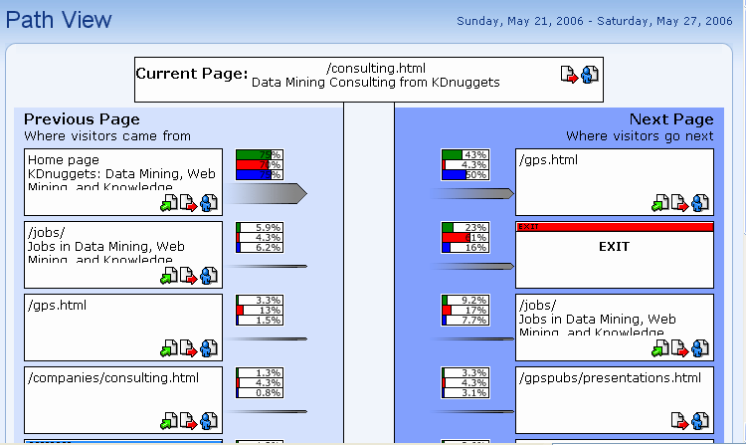
ClickTracks Path View
Path view (partial) for
www.kdnuggets.com/consulting.html page

